Slide 1

Notes:
We can do this in-person later and internationally.
This material is updated monthly.

Slide 2

Please silence cell phones

Slide 3


Slide 4
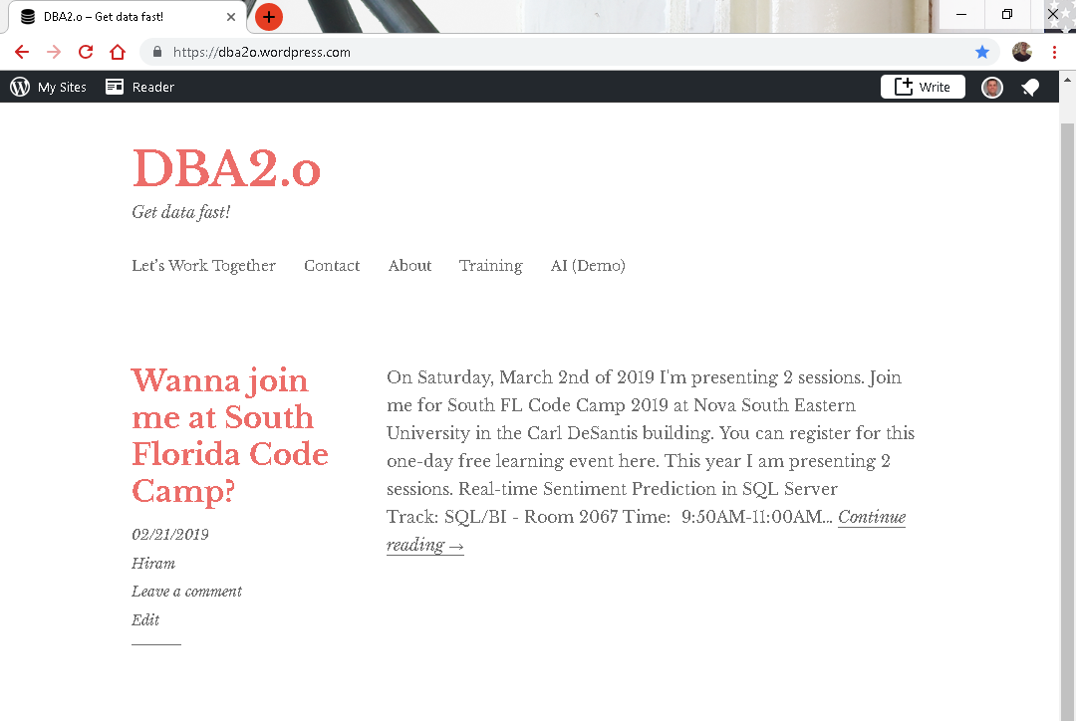

Slide 5
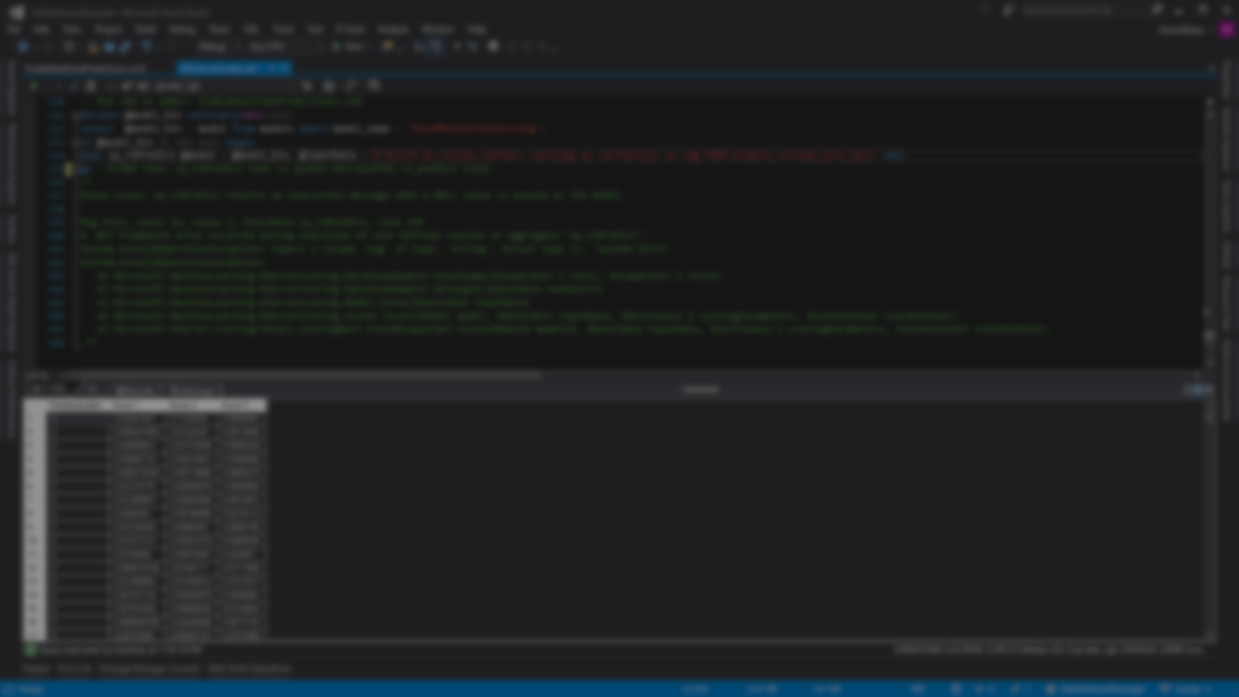
Session evaluations
This is the link:
bit.ly/pbi18
Your feedback is very important.
Submit your feedback by the end of this presentation.

Slide 6



BIO
Father
Principal DB Architect
Power BI since 2016
SQL Server since 1999
Developer since 1995
USCG Auxiliary Staff Officer
Microsoft Certified Professional
Power BI Certified
Hiram Fleitas
Instructor
FUN
Construction & Family
/HiramFleitas
/hfleitas
@HiramFleitas
hiram@fleitasarts.com
HiramFleitas
fleitasarts.com

Slide 7
Schedule (times are approximate and will be fluid with the class)
Morning
09:00 AM – 11:45 AM – Advanced Data Modeling
Afternoon
11:45 AM – 1:00 PM – Power BI Administration
Notes:
Key message: in this workshop we will cover the breath of Power BI capabilities.
After analyzing and visualizing the dataset provided in the workshop, you will use the these skills to get started on your own data.

Slide 8
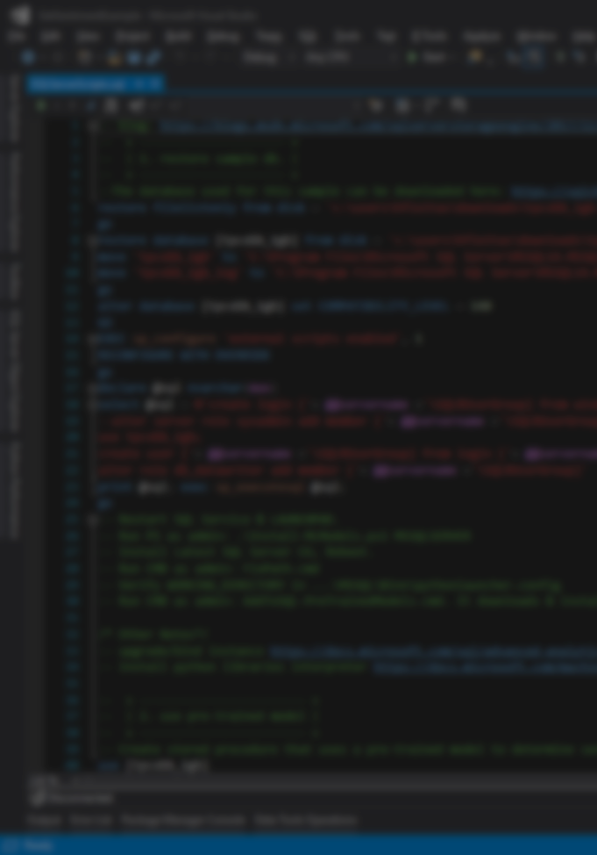
Agenda
Filtering (20min)
Cross-Filtering and Time Intelligence (20min)
Many to Many with DAX (15min)
Creating a Bridge Table (20min)
Role Playing Tables with DAX (20min)
Role Playing Tables without DAX (20min)
Mismatched Granularities (30min)
Weighted Allocation (20min)
Data Refresh Overview (20min)
Scheduling Data Refresh (20min)
Implementing Row Level Security (20min)
Implementing Dynamic Security (15min)

Slide 9
Agenda
Power BI Embedded (20min)
Key Influencers (20min)
Automated-ML (20min)
New Features Announcements (30min)
Q&A + Resources (30min)

Slide 10

Advanced Data Modeling
Filtering
Notes:
In previous courses we show you how to build a relationship in the data model, but we really don’t go into detail why we build the relationship the way that we do and some of the available options. So we’re going to talk about Filtering now and we’re going to get into Cross-Filtering as well. Because Cross-Filtering is going to give us support for Many to Many relationships.

Slide 11
Single Filtering
Products
Sales
Customers
ProdID | Name | Price
101 | Bike | 250
102 | Socks | 10
103 | Shoes | 120
104 | Helmet | 150
105 | Gloves | 45
CustID | ProdID | Amt | QTY
3 | 101 | 250 | 1
3 | 102 | 20 | 2
1 | 105 | 45 | 1
2 | 105 | 45 | 1
2 | 104 | 150 | 1
3 | 104 | 150 | 1
4 | 101 | 250 | 1
CustID | Name
1 | Christina
2 | Ocean
3 | Skylar
4 | Brent
5 | Regis
Filtering
Automatically occurs from the single side of the relationship.
Notes:
Because of the relationship product filtering sum totals change.

Slide 12
Many to Many relationships
Customers
Products
Customer 1 – Buys Milk & Bread
Customer 2 – Buys Milk & Coffee
Customer 3 – Buys Sugar
Milk – Customers 1, 2, 4, 5
Bread – Customers 1, 4, 6, 7
Question
How many customers have purchased each product?
Notes:
This is when you have 2 tables and they have many to many relationship. You can’t build a relationship between 2 tables that have a many to many relationship. You need a Bridge Table.

Slide 13
Cross Filtering
Products
Sales
Customers
ProdID | Name | Price
101 | Bike | 250
102 | Socks | 10
103 | Shoes | 120
104 | Helmet | 150
105 | Gloves | 45
CustID | ProdID | Amt | QTY
3 | 101 | 250 | 1
3 | 102 | 20 | 2
1 | 105 | 45 | 1
2 | 105 | 45 | 1
2 | 104 | 150 | 1
3 | 104 | 150 | 1
4 | 101 | 250 | 1
CustID | Name
1 | Christina
2 | Ocean
3 | Skylar
4 | Brent
5 | Regis
Filtering
Automatically occurs from the single side of the relationship.
Notes:
Because of the current state of this data model its going to count all records in the customer table for product ID 101 Bikes and say the count of customers is 5, which is incorrect cause it should be 2 but it can’t filter the customer table. This is confusing if you don’t come from an IT or BI background, or perhaps its not advanced for you. But what we do is Turn on Cross Filtering and the Transactional table (Sales) is going to be able to filter the Customers table based on CustID.

Slide 14
Cross Filtering
DEMO 1
Notes:
In this demo, we take a look at when we transition from a single sided relationship to a cross-sided relationship.

Slide 15

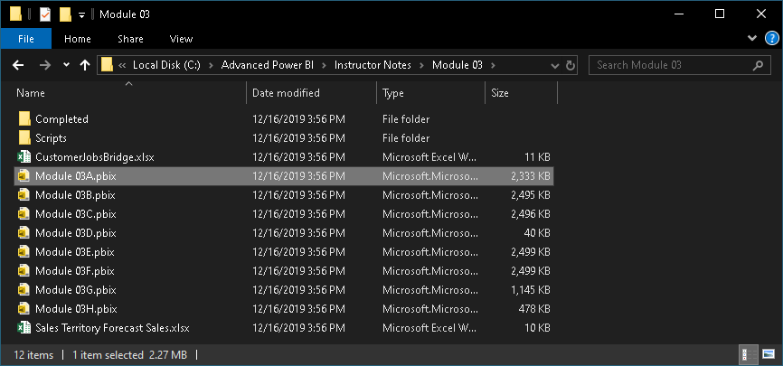
Module 03
C:\Advanced Power BI\Instructor Notes\Module 03\Module 03A.pbix

Slide 16
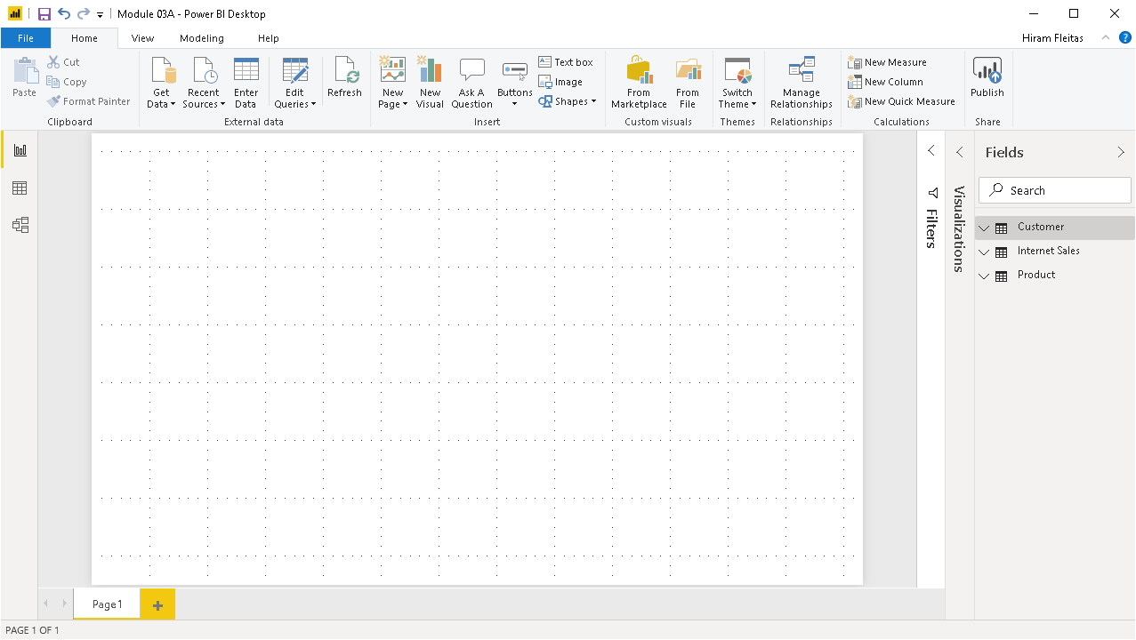

Notes:
3 simple tables. Internet Sales table (or bridge table) holds the relationship between Customer and Product.

Slide 17
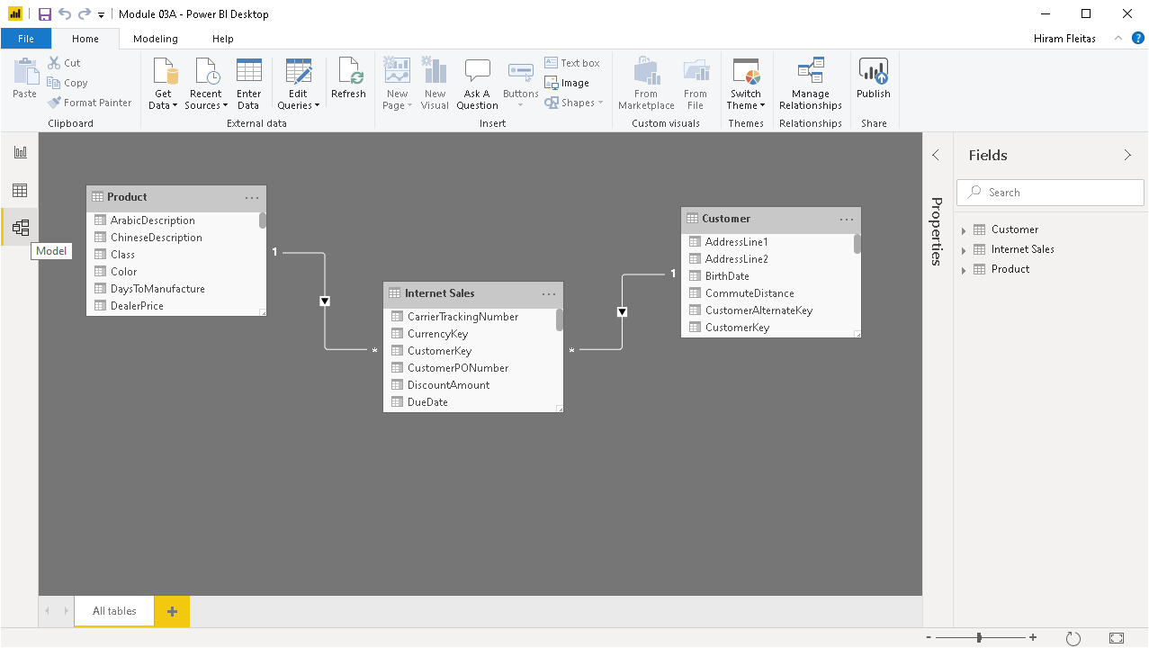

Slide 18
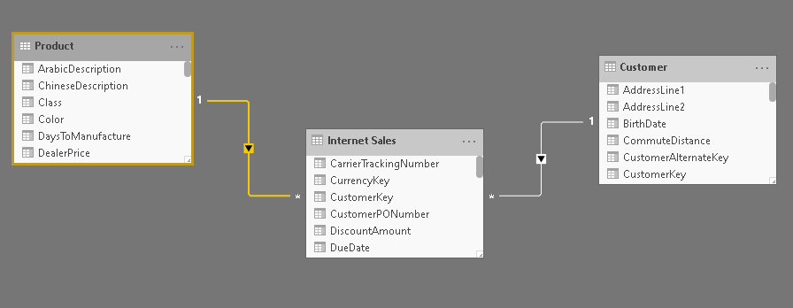
The One-side of the relationship
Directional triangle, indicating Product filters Internet Sales
Directional triangle, indicating Customer filters Internet Sales
The Many-side of the relationship
Notes:
Power BI is great at visually easily showing us the current relationships that we have.

Slide 19
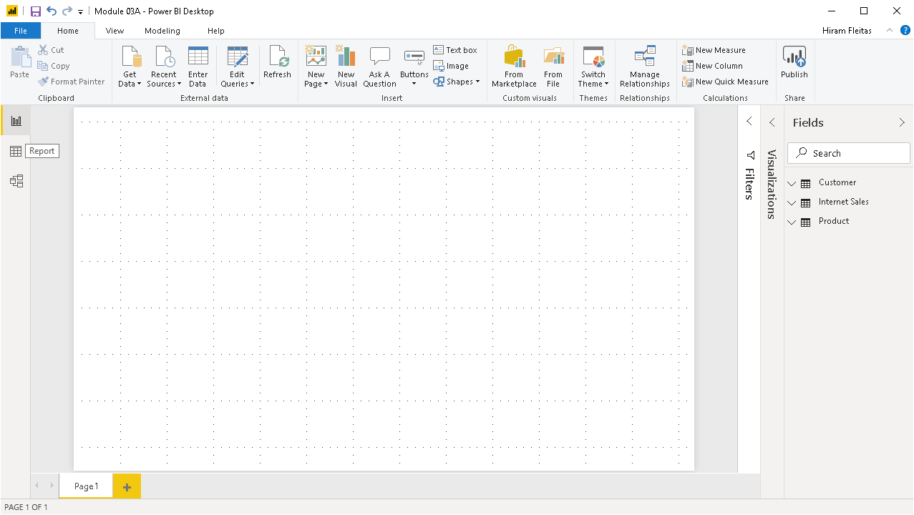

Slide 20
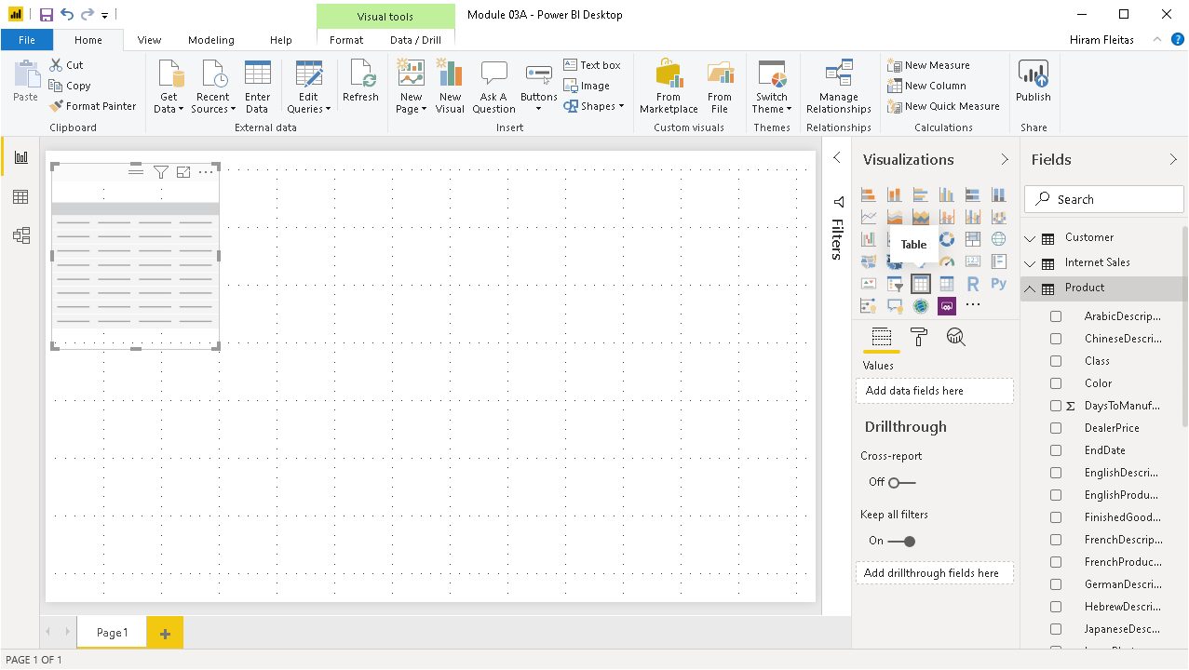

Slide 21
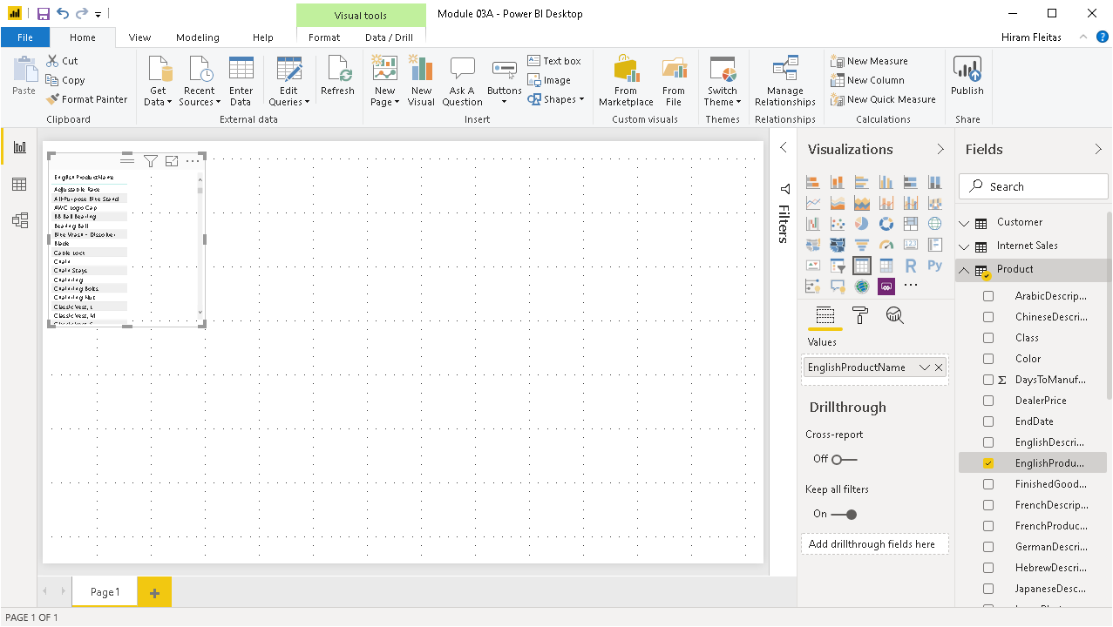

Slide 22
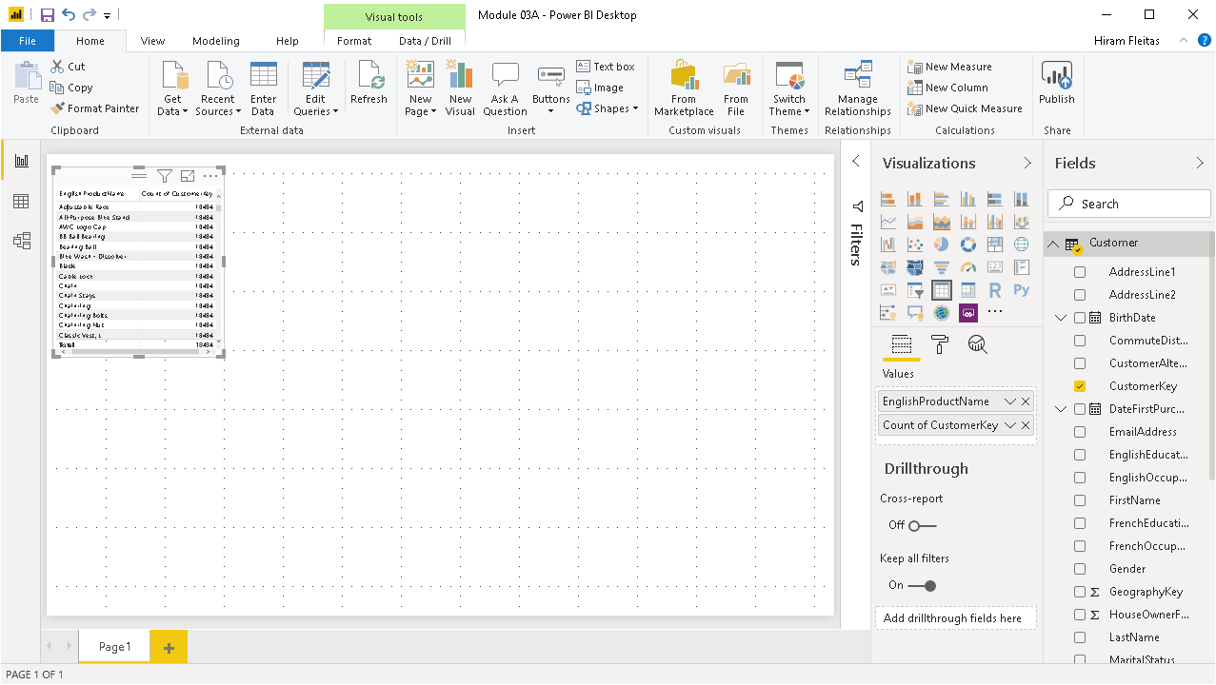

Slide 23
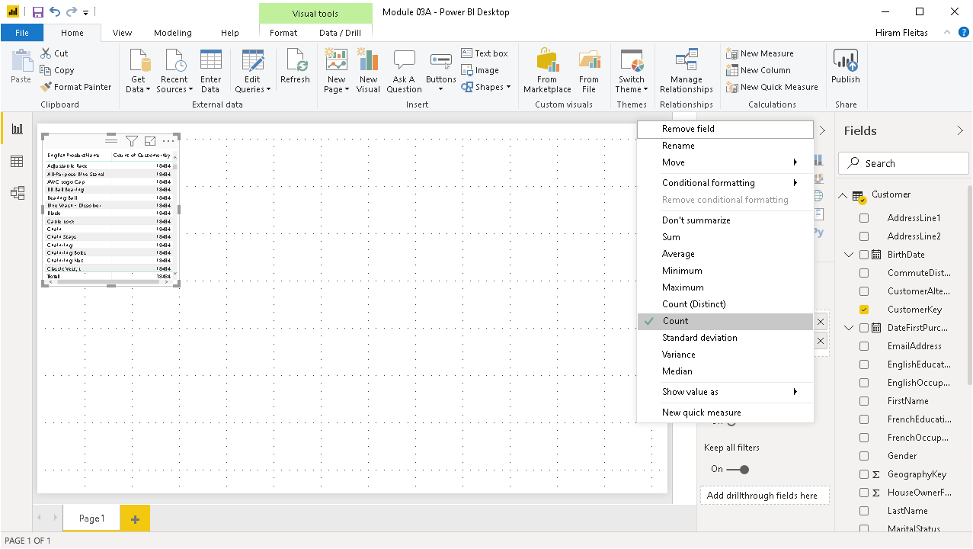

Slide 24
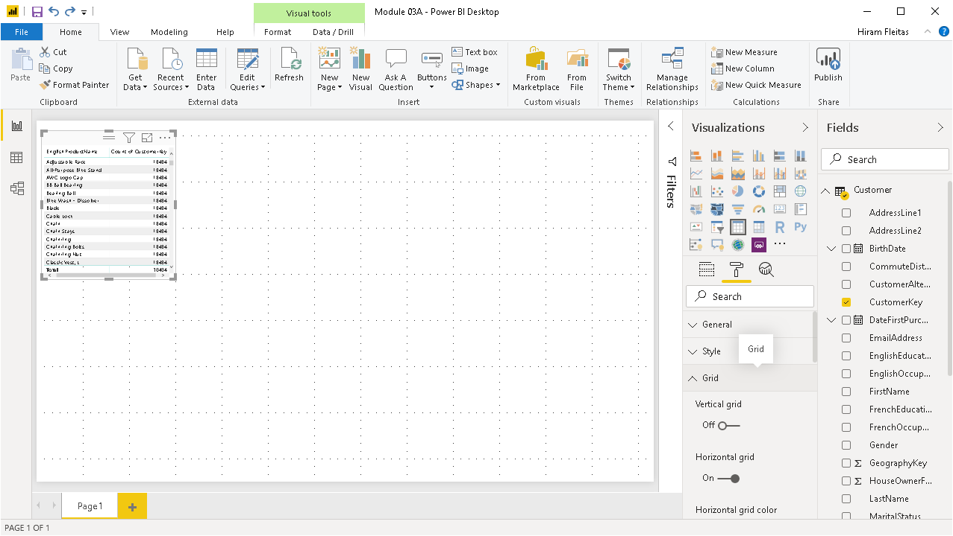

Slide 25
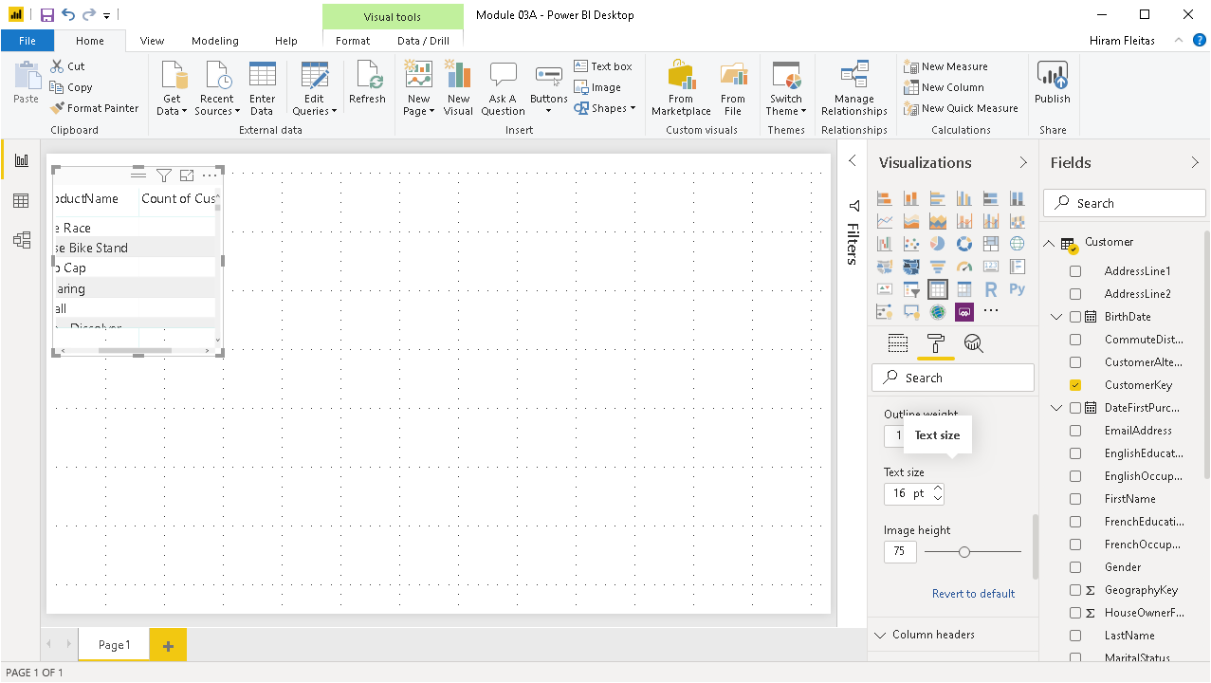

Slide 26
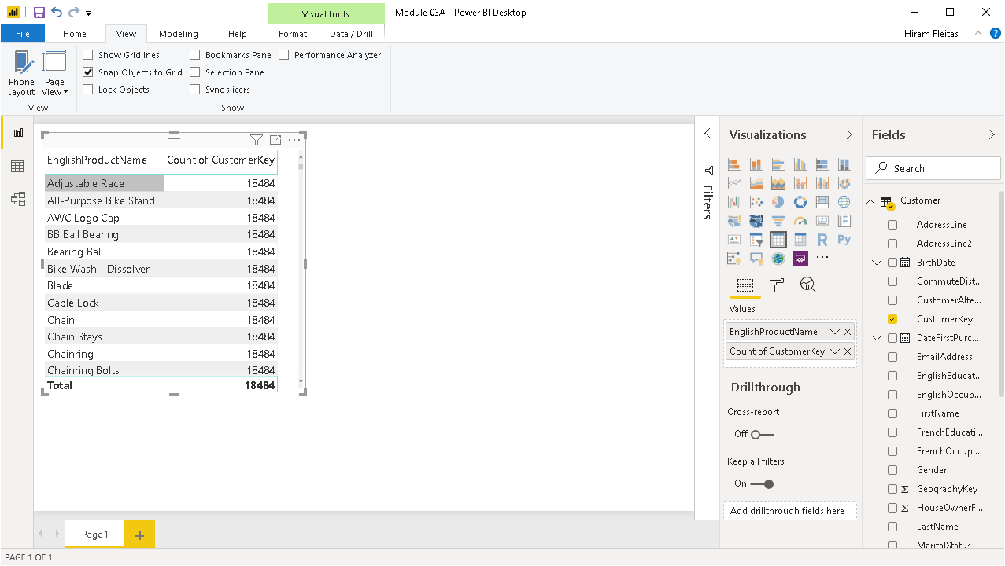
Duplicated value, typically due to a relationship doesn’t exist or its on the wrong column or data type.
We want a count of only the customers who purchased that product, not every single customer in the table.
Notes:
The fact table is not able to filter down the Customer table. Once we understand filtering and cross-filtering, this is a very easy problem to solve. We need to turn on Cross-Filtering to solve this problem.

Slide 27
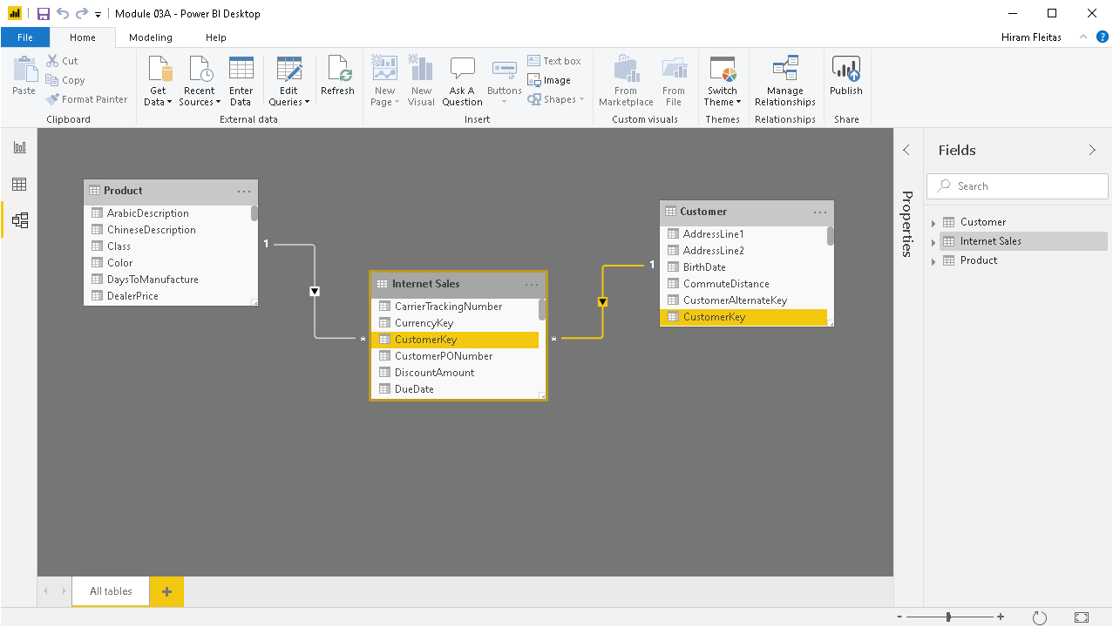
Double-click the relationship

Slide 28
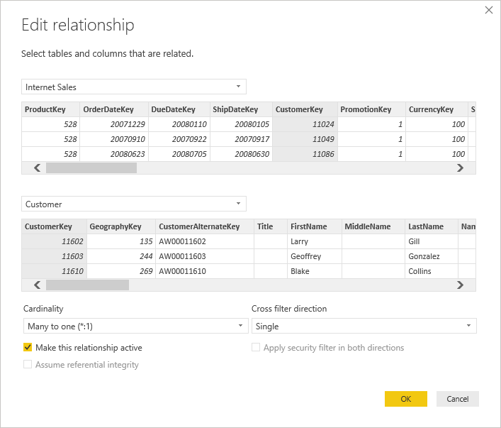
1st
2nd
Verify the relationship is built correctly. It is on CustomerKey.
Internet Sales to Customer

Slide 29
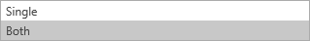

Slide 30
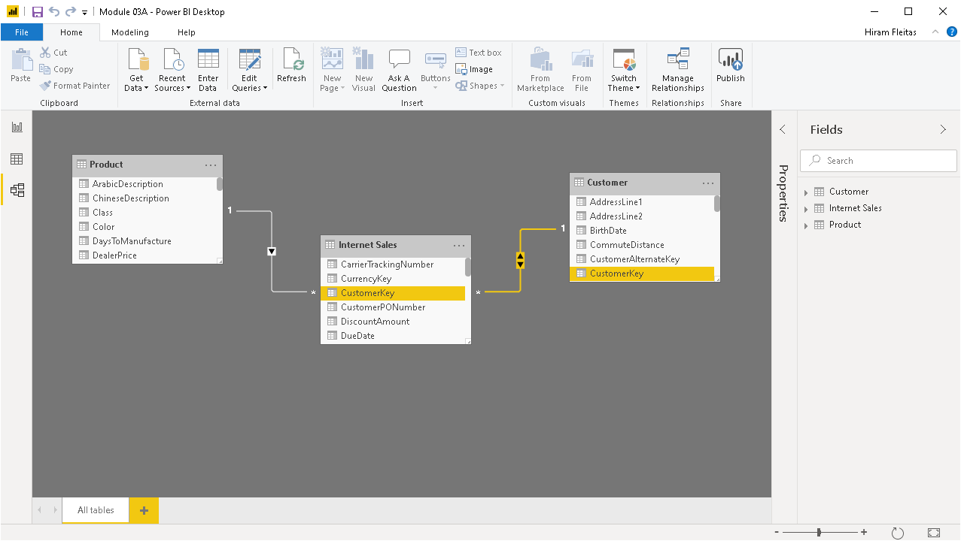
Notice the arrow now goes in BOTH directions
Notes:
IMPORTANT: If the Internet Sales table is filtered by anything else, it will allow to filter the Customer table.

Slide 31
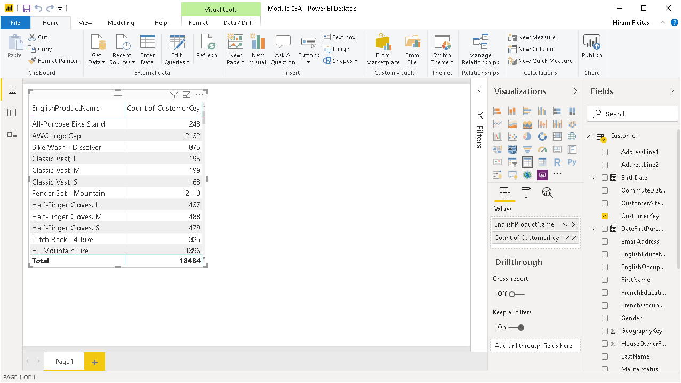
Notice our results have changed. Without having to write T-SQL or MDX or any verbose code.
This is one simple measure because of the relationship in the data model.

Slide 32
Review
Relationships
Pop-Up Quiz # 1
bit.ly/pbi18
One to Many
Many to Many
Filtering
Single (default)
Both
Notes:
We covered very important concepts, first one to many. What is the one side and what is the many side. Then how you can come up with interesting reports around that. For examples, Customers that bought products. Then we talked about single side filtering, default behavior. The one side relationship always filters the many side. Then we talked about Both, this is where the single side can filter the many side AND the many side can filter the single side.

Slide 33
Advanced Data Modeling
Cross-Filtering and Time Intelligence
Notes:
We’re going to focus now more on Time Intelligence

Slide 34
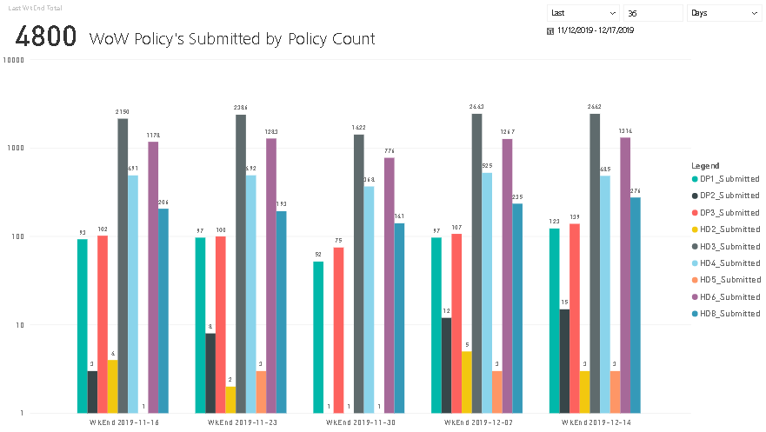
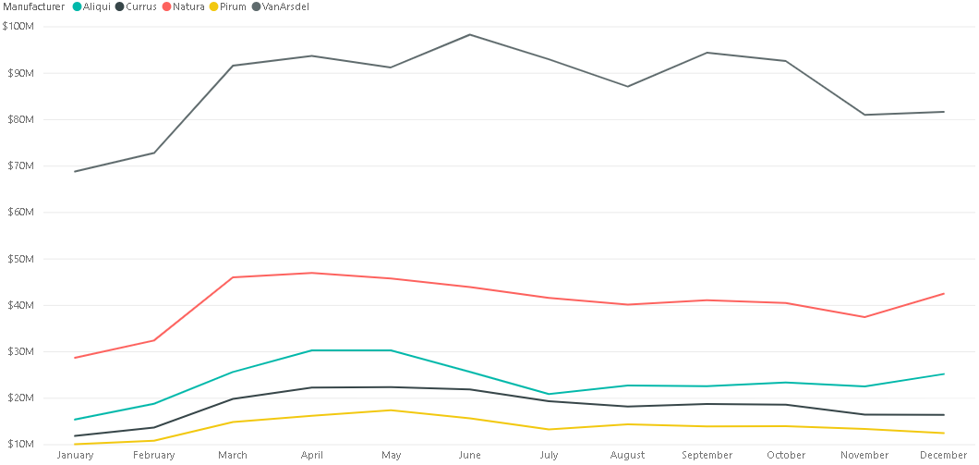
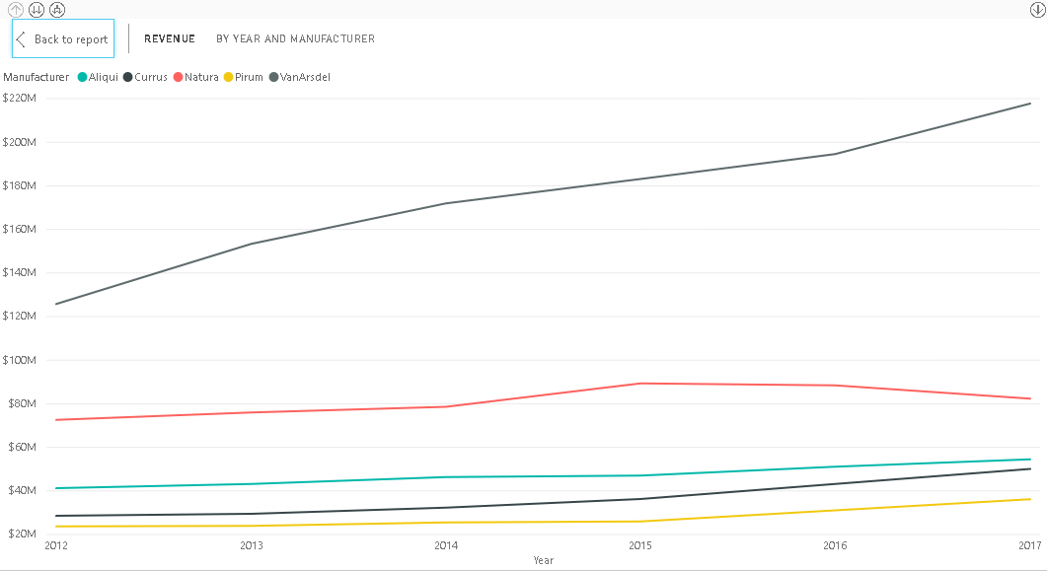
Using Time Intelligence
Comparing Data over Time
Year-to-Date
Year Over Year Growth
Using a Date Table
We’re looking at our data but in perspective of time. This year vs last year. So when you’re working with Time Intelligence you need to have a separate table that has a column that has all the dates.
Source:
http://fleitasarts.com, PBI (Demo)
Notes:
We’re looking at our data but in perspective of time. This year vs last year. So when you’re working with Time Intelligence you need to have a separate table that has a column that has all the dates.

Slide 35
Year over Year
Source:
http://fleitasarts.com, PBI (Demo)

Slide 36
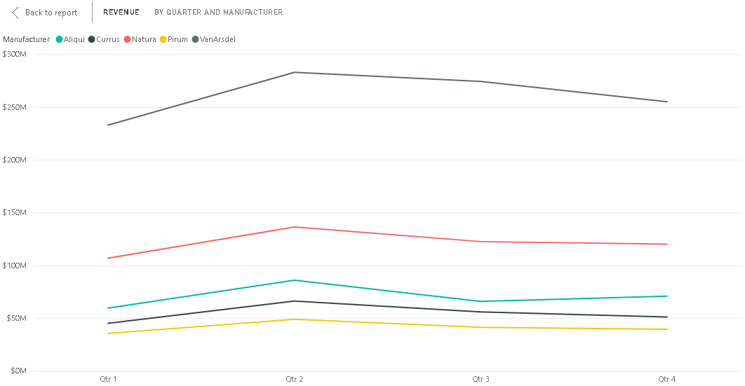
Quarter over Quarter
Source:
http://fleitasarts.com, PBI (Demo)

Slide 37
Month over Month
Source:
http://fleitasarts.com, PBI (Demo)

Slide 38
Week over Week
Source:
http://fleitasarts.com, PBI (Demo)

Slide 39
Creating Date Tables
Date Table Requirements
DateKey | DateLabel
1/1/2019 12:00:00 AM | 2019-01-01
1/2/2019 12:00:00 AM | 2019-01-02
1/3/2019 12:00:00 AM | 2019-01-03
1/4/2019 12:00:00 AM | 2019-01-04
1/5/2019 12:00:00 AM | 2019-01-05
1/6/2019 12:00:00 AM | 2019-01-06
1/7/2019 12:00:00 AM | 2019-01-07
1/8/2019 12:00:00 AM | 2019-01-08
1/9/2019 12:00:00 AM | 2019-01-09
1/10/2019 12:00:00 AM | 2019-01-10
1/11/2019 12:00:00 AM | 2019-01-11
One row for every date.
Span range of possible dates.
Import from source or create a new table in DAX.
Mark as a Date Table in Model (Tabular).
Date column passed to Time Intelligence functions.
Notes:
The date table needs to have a row for every possible date. Dates that span all ranges. Because if you setup cross-filtering between your date table and your transactions table, it’s going to allow the transactions table to filter the date table. If it can filter the date table, then dates will disappear from your date table and disappear. Therefore it wont span all possible date ranges so time intelligence doesn’t work.

Slide 40
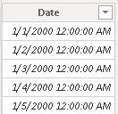
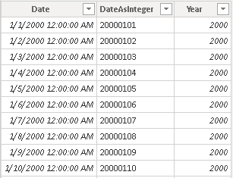
Create a Date Table in DAX
Method 1
Date =
CALENDAR ( DATE ( 2000, 1, 1 ), DATE ( 2025, 12, 31 ) )
Method 2
Date =
ADDCOLUMNS (
CALENDAR ( DATE ( 2000, 1, 1 ), DATE ( 2025, 12, 31 ) ),
"DateAsInteger", FORMAT ( [Date], "YYYYMMDD" ),
"Year", YEAR ( [Date] )
)
Steps
Under Modeling, click New Table, and paste in formula bar.
Notes:
The date table needs to have a row for every possible date. Dates that span all ranges.

Slide 41
Create a Date Table in DAX
Method 3
Date =
ADDCOLUMNS (
CALENDAR ( DATE ( 2000, 1, 1 ), DATE ( 2025, 12, 31 ) ),
"DateAsInteger", FORMAT ( [Date], "YYYYMMDD" ),
"Year", YEAR ( [Date] ),
"Monthnumber", FORMAT ( [Date], "MM" ),
"YearMonthnumber", FORMAT ( [Date], "YYYY/MM" ),
"YearMonthShort", FORMAT ( [Date], "YYYY/mmm" ),
"MonthNameShort", FORMAT ( [Date], "mmm" ),
"MonthNameLong", FORMAT ( [Date], "mmmm" ),
"DayOfWeekNumber", WEEKDAY ( [Date] ),
"DayOfWeek", FORMAT ( [Date], "dddd" ),
"DayOfWeekShort", FORMAT ( [Date], "ddd" ),
"Quarter", "Q" & FORMAT ( [Date], "Q" ),
"YearQuarter", FORMAT ( [Date], "YYYY" ) & "/Q"
& FORMAT ( [Date], "Q" )
)
Notes:
The date table needs to have a row for every possible date. Dates that span all ranges.

Slide 42
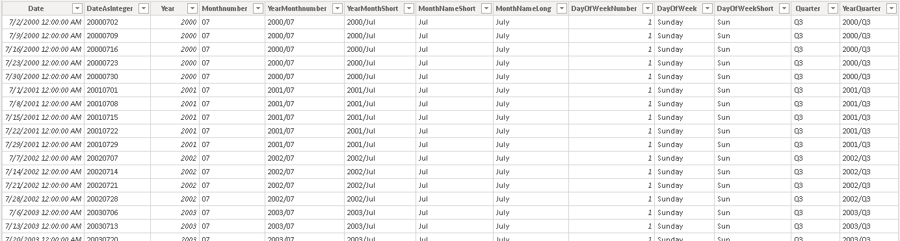
Create a Date Table in DAX
Method 3

Slide 43
Cross Filtering
Products
Sales
Date
ProdID | Name | Price
101 | Bike | 250
102 | Socks | 10
103 | Shoes | 120
104 | Helmet | 150
105 | Gloves | 45
DateSK | ProdID | Amt | QTY
20190101 | 102 | 250 | 1
20190101 | 101 | 20 | 2
20190102 | 101 | 45 | 1
20190103 | 105 | 45 | 1
20190103 | 104 | 150 | 1
20190104 | 104 | 150 | 1
20190105 | 101 | 250 | 1
DateSK | Date
20190101 | 1/1/2019
20190102 | 1/2/2019
20190103 | 1/3/2019
20190104 | 1/4/2019
20190105 | 1/5/2019
Question
How many dates was a product purchased?
Bikes 3, Socks 1, Shoes 0. But Time Intelligence breaks due to filtered date table. Its not a continuous range of dates.

Slide 44
Cross Filtering and Time Intelligence
DEMO 2
Notes:
In this demo, we take a look at when we transition from a single sided relationship to a cross-sided relationship.

Slide 45
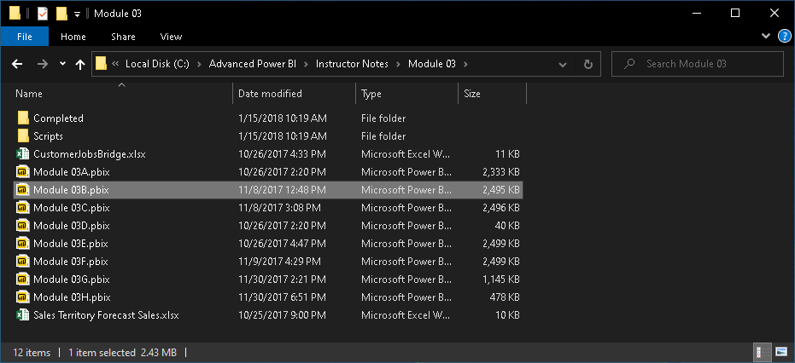
Module 03
C:\Advanced Power BI\Instructor Notes\Module 03\Module 03B.pbix

Slide 47
Notes:
3 simple tables. Internet Sales table (or bridge table) holds the relationship between Customer and Product.

Slide 56

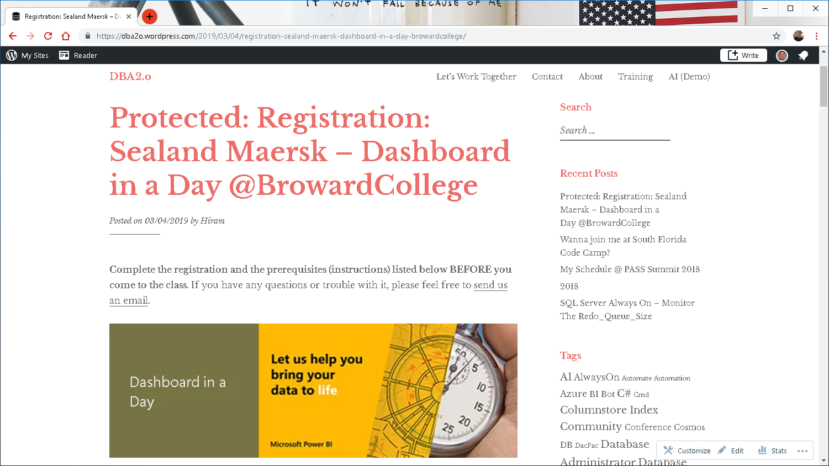


Pop Quiz
Pre-lab: goo.gl/e1r2iq
Get Data: goo.gl/GiuiMV
Data Prep: goo.gl/UjmsLV
Model and Explore: goo.gl/mpCUSC
Visualizations: goo.gl/qEbruw
Power BI Service: goo.gl/2b9HYH
Notes:
That’s a lot of elements we covered.
We talked about the Power BI Desktop tool, Get Data, Look and Feel, Visuals, Fields, Formatting.
Hopefully, this has demystified things a little.
DIAD Pre-lab Quiz: https://goo.gl/e1r2iq
So lets start the lab itself.

Slide 57
DEMOS
Power BI Service
Gateway
Schedule Refresh
Security
Walkthrough
Dashboards
Reports
Datasets
Alerts
Q&A
Excel Workbooks
Collaboration using Apps

Slide 58
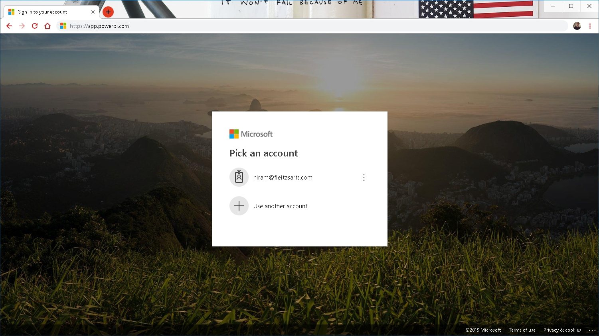
Notes:
1. Sign into https://app.powerbi.com. Let’s talk about configuring the gateway
2. From the menu on the top right, click on the gear and select Manage gateways
3. You will be navigated to Gateways screen. Notice the gateway you added is available

Slide 59
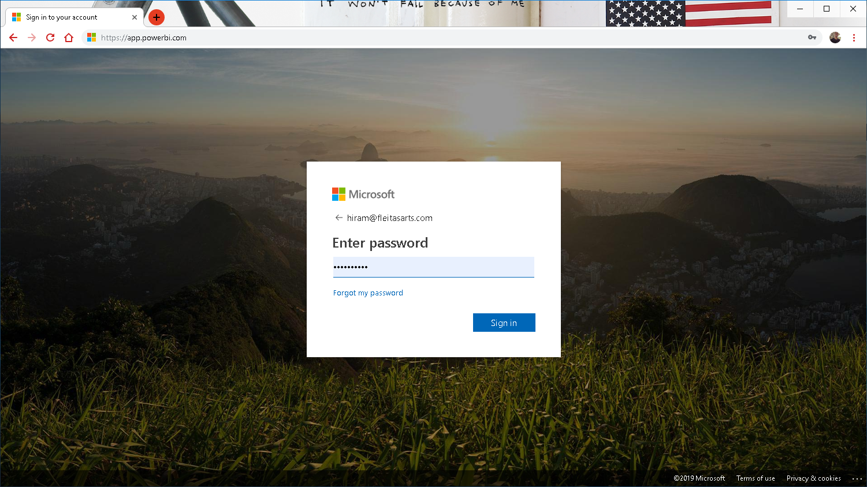
Notes:
Login to https://app.powerbi.com impersonating an end user. Launch DIAD app

Slide 60
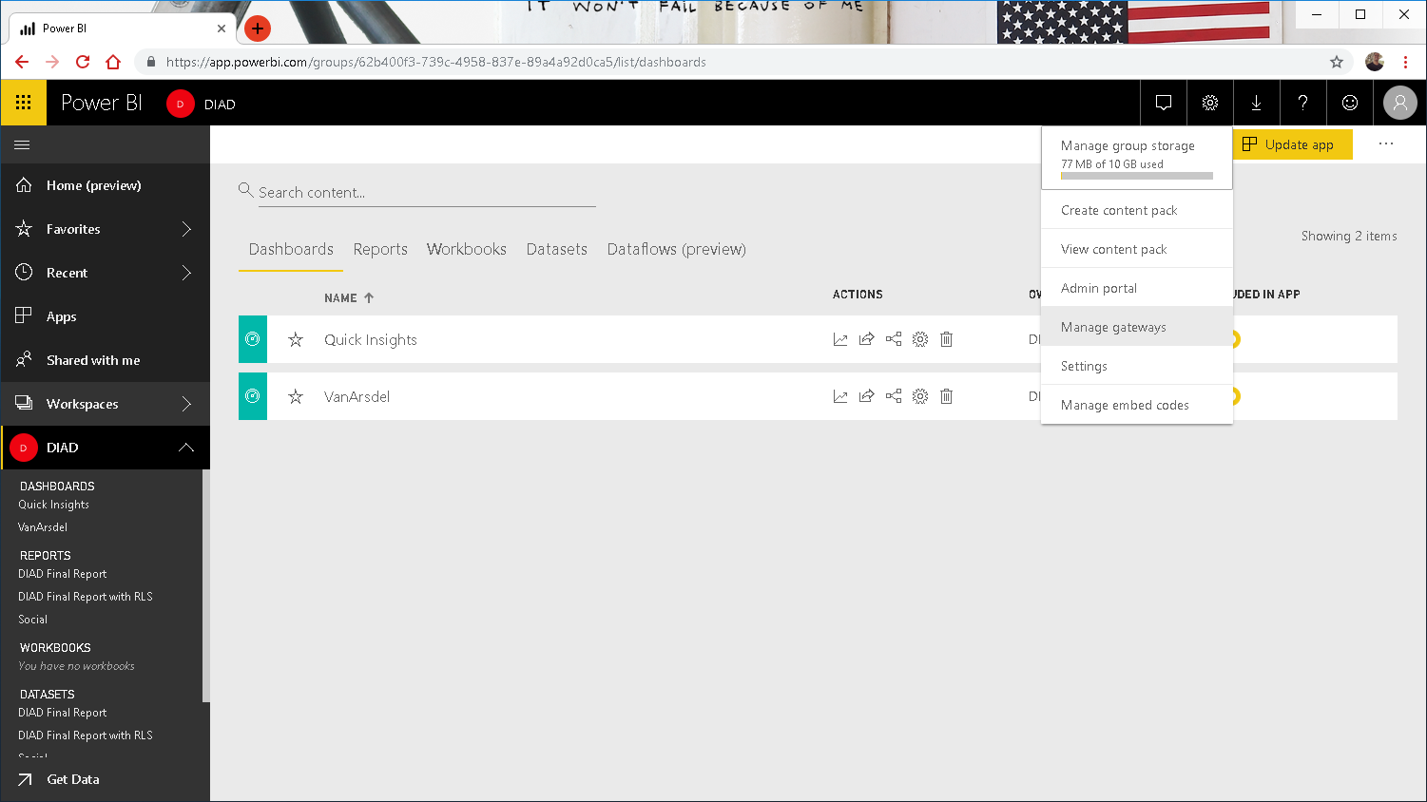
Notes:
Using the line chart talk about the fact that VanArsdel has a large market share compared to other manufacturers. Also notice that sales are increasing YoY.

Slide 61
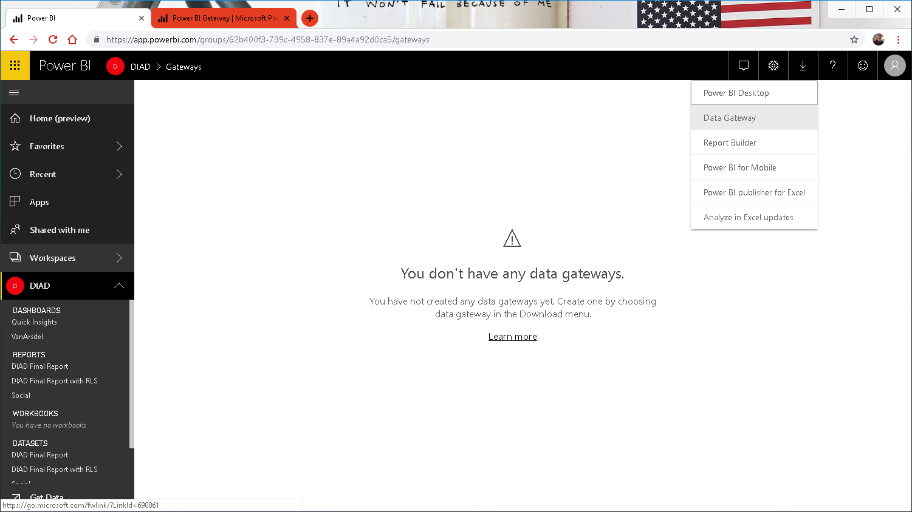
Notes:
Login to https://app.powerbi.com impersonating an end user. Launch DIAD app

Slide 62
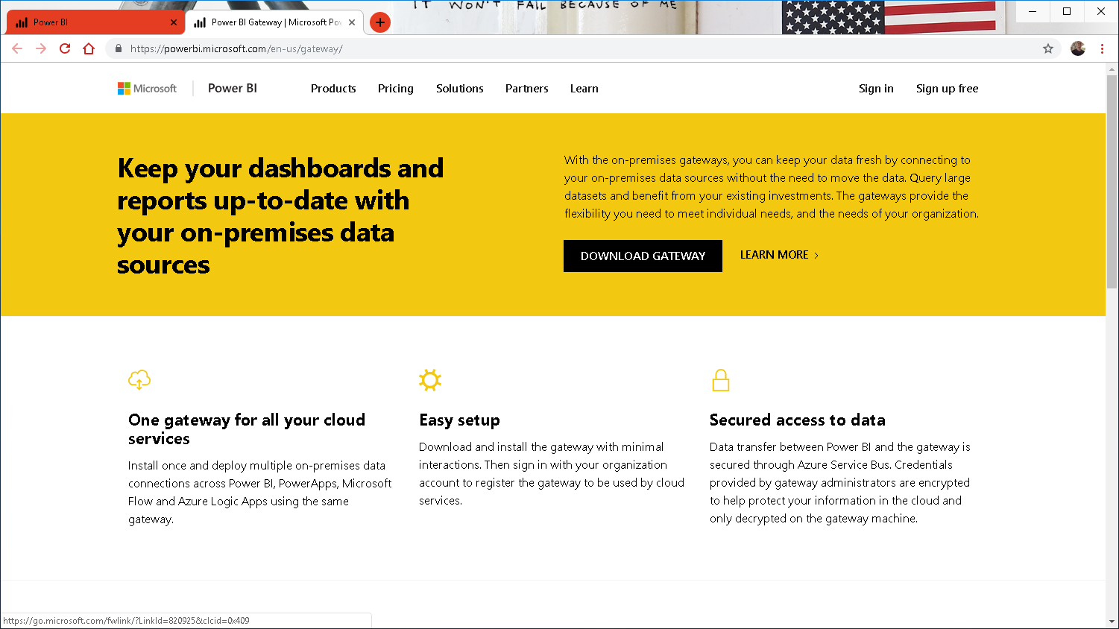

Slide 63
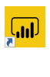
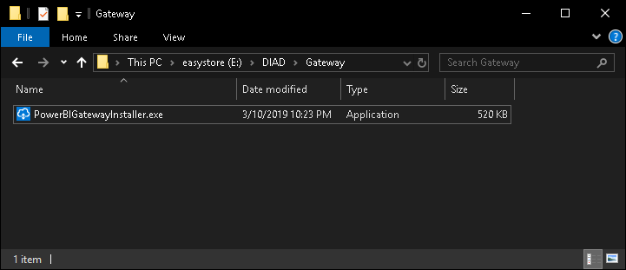
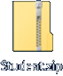
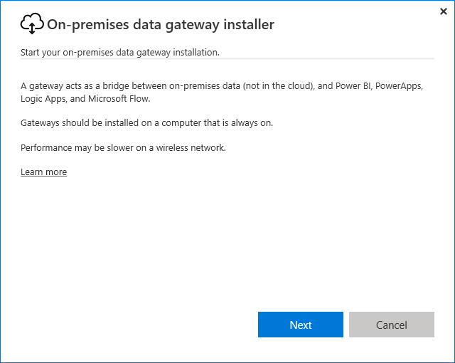
Notes:
Login to https://app.powerbi.com impersonating an end user. Launch DIAD app

Slide 64
Notes:
Login to https://app.powerbi.com impersonating an end user. Launch DIAD app

Slide 65
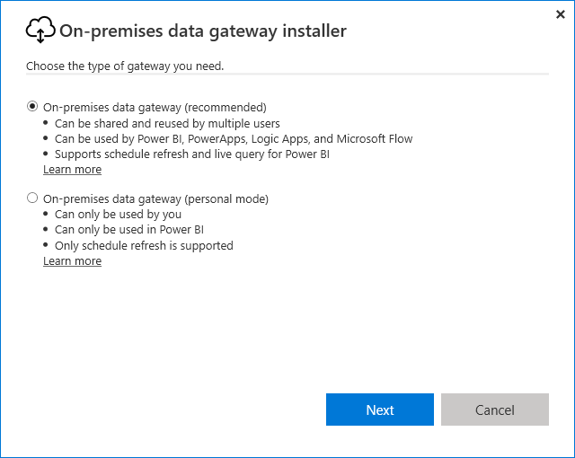
Notes:
Login to https://app.powerbi.com impersonating an end user. Launch DIAD app

Slide 66
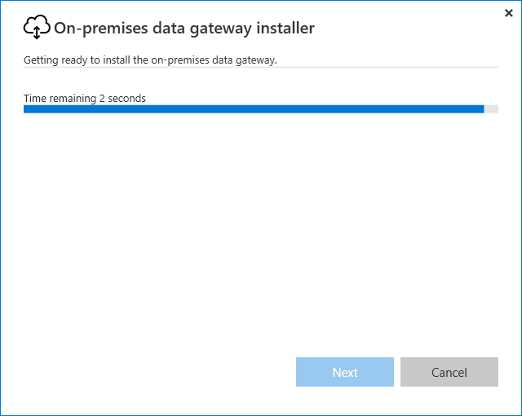
Notes:
Login to https://app.powerbi.com impersonating an end user. Launch DIAD app

Slide 67
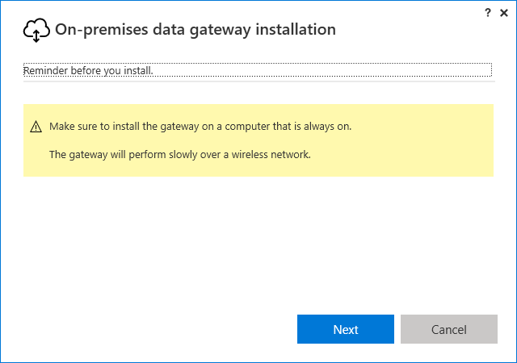
Notes:
Login to https://app.powerbi.com impersonating an end user. Launch DIAD app

Slide 68
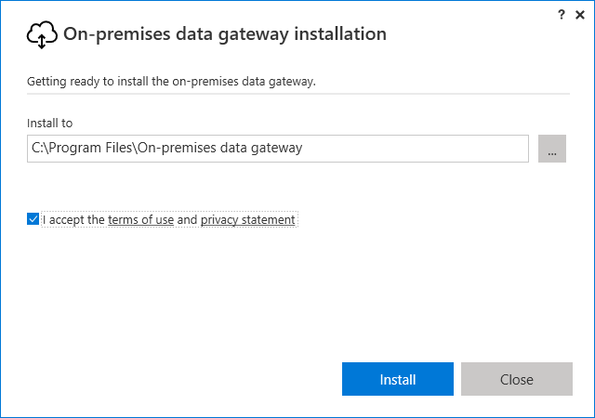
Notes:
Install Gateway, at this point the Windows ACU prompt.

Slide 69
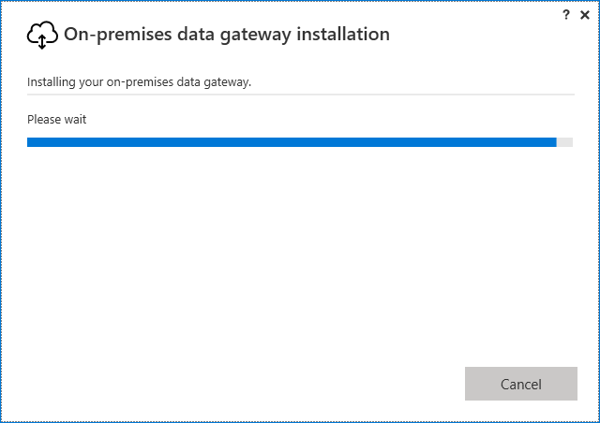
Notes:
Install Gateway, at this point the Windows ACU prompt again.

Slide 70
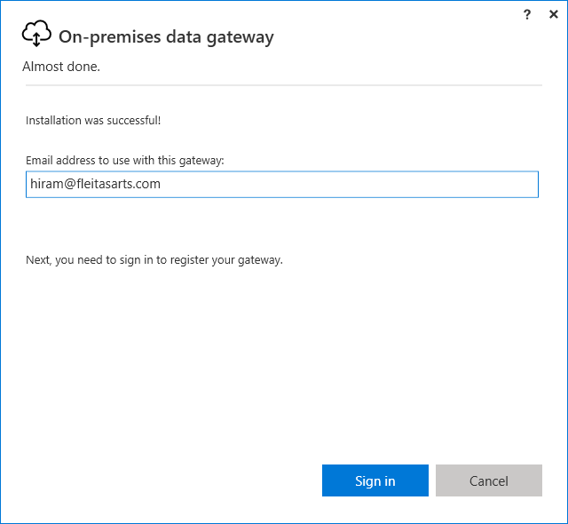
Notes:
Install Gateway, at this point the Windows ACU prompt again.

Slide 71
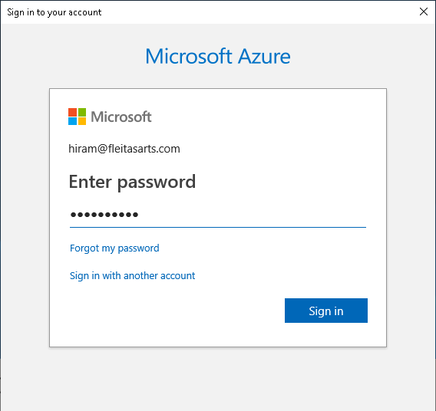
Notes:
Login to https://app.powerbi.com impersonating an end user. Launch DIAD app

Slide 72
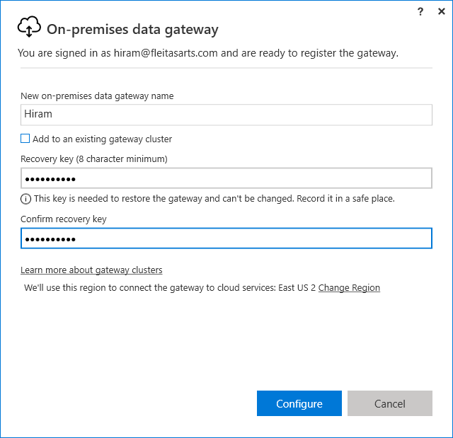
Notes:
Login to https://app.powerbi.com impersonating an end user. Launch DIAD app

Slide 73
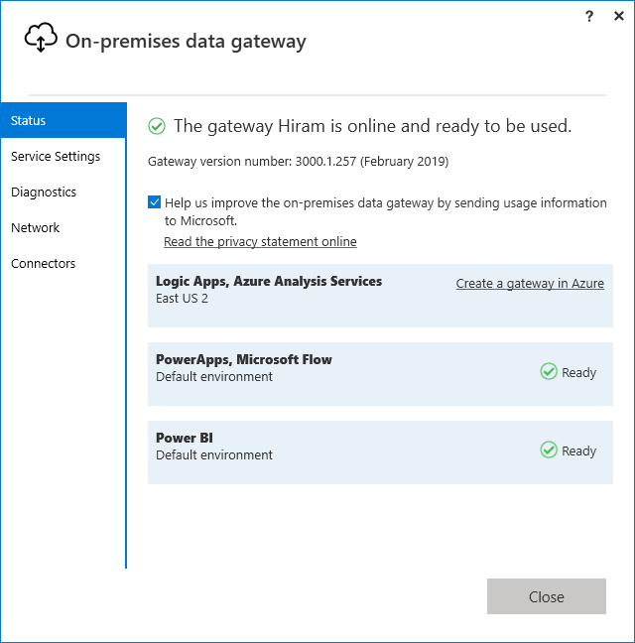
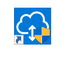
Notes:
At this point the Gateway is installed and running.
See Service Settings, Diagnostics, Network and Connectors for more info.

Slide 74
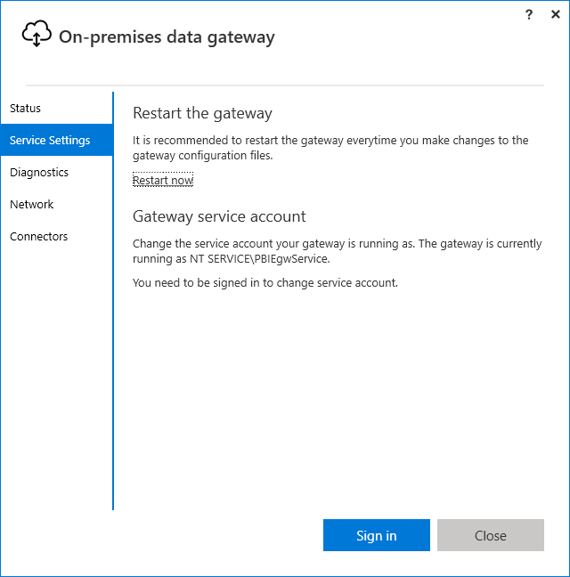
Notes:
At this point the Gateway is installed and running.
See Service Settings, Diagnostics, Network and Connectors for more info.

Slide 75
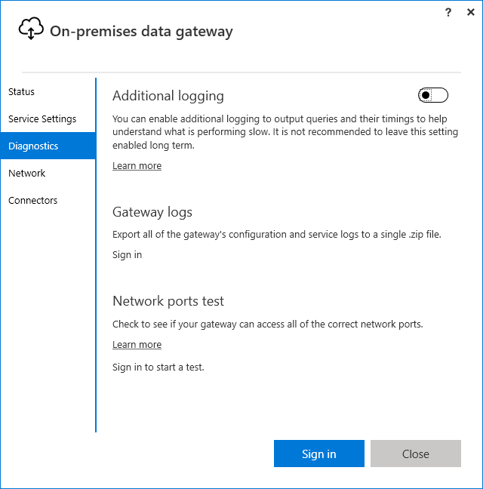
Notes:
At this point the Gateway is installed and running.
See Service Settings, Diagnostics, Network and Connectors for more info.

Slide 76


Notes:
At this point the Gateway is installed and running.
See Service Settings, Diagnostics, Network and Connectors for more info.

Slide 77

Notes:
At this point the Gateway is installed and running.
See Service Settings, Diagnostics, Network and Connectors for more info.

Slide 78
Notes:
2. From the menu on the top right, click on the gear and select Manage gateways

Slide 79

Notes:
3. You will be navigated to Gateways screen. Notice the gateway added is available.
The data gateway acts as a bridge, providing quick and secure data transfer between on-premises data (data that is not in the cloud) and the Power BI, Microsoft Flow, Logic Apps, and PowerApps services.
4. On the right panel of the screen you can add more information

Slide 80

Notes:
5. On the right panel of the screen there is also an option to add Administrators for the gateway

Slide 81

Notes:
Click the elipses to Add Data Source

Slide 82


Notes:
If you’re PC is on domain put the domain name in-front of the username ie. FleitasArts\hfleitas
Notice options under Advanced settings, Privacy Level default is Organizational.
Click Add.

Slide 83

Notes:
Connection must say Successful

Slide 84

Notes:
Connection must say Successful.
Note, Folder.

Slide 85

Notes:
Now let’s look at how refresh is going to work.
22. If the left panel is collapsed, expand it by clicking on the three bars below PowerBI.
23. Navigate to Datasets section on the left panel and locate the dataset called DIAD Final Report. Click on the ellipses and click on Schedule Refresh as shown in the screenshot.

Slide 86

Notes:
In the Settings page, you will see the Datasets section is selected.
24. The Power BI service has detected that you have setup a Gateway. Expand Gateway connection.
25. Select Use a data gateway and click Apply.
A dialog appears confirming the gateway for DIAD- Report Final has been updated.

Slide 87

Notes:
Now let’s schedule data refresh. Notice that you do not have to re-enter the credentials for each data source again. Since it is set up at the gateway level.
26. Expand Schedule Refresh section.
27. Enable data refresh by moving the slider below “Keep your data up to date”.
28. There are two options for Refresh Frequency, daily and weekly. Pick Daily.
29. Using “Time Zone” drop down update the time zone to the appropriate selection.
30. Click on “Add another time” to select refresh time.
31. Data refresh can be scheduled on the hour or 30min.

Slide 88

Notes:
The company sold Germany, so lets remove it from the folder.

Slide 89

Notes:
After the Refresh completes, the report will not longer show the Germany bubble on the map under EUROPE.

Slide 90

Notes:
I set the service to Log On As my account so it could access the directory.
This will require to open the On-Premises data gateway, login again and recover the gateway using the key.

Slide 91

Notes:
Germany no longer appears in the map visual.

Slide 92



Notes:
Now we have the model and report ready, we want to add security around it, so that individuals from a USA view only USA data and individuals from Mexico view only Mexico data and so forth.
1. From the ribbon select Modeling -> Manage Roles.
2. Manage roles dialog opens. Click on Create button.
3. Name the role as US Role.
4. Click on the ellipsis next to Geography.
5. Select Add Filter -> [Country].
Notice a DAX Expression appears in the text area.
6. Edit the DAX Expression to [Country] = "USA".
Click on the check mark on the top right corner. This will validate the DAX expression.
Similarly add roles for Australia, Canada, France, Japan and Mexico using the following DAX Expressions. Australia Role [Country] = "Australia"
Canada Role [Country] = "Canada"
Germany Role [Country] = "Germany"
Japan Role [Country] = "Japan"
Mexico Role [Country] = "Mexico"
Nigeria Role [Country] = "Nigeria"

Slide 93

Notes:
Notice now you are viewing as a person with Mexico Role would view.
11. Click on Stop viewing to exit Mexico Role view.
We will add users to these roles in the service. You should have already

Slide 94


Slide 95

Notes:
Type the email, select the correct one as it appears, click Add, click Save.

Slide 96

Notes:
To remove, click the X and then click Save again.

Slide 97

Notes:
Walkthrough the Power BI Service layout
Your workspace is made up of:
1. navigation bar
2. dashboard with tiles
3. Q&A question box
4. help and feedback buttons
5. dashboard title
6. Office 365 app launcher
7. Power BI home buttons
8. Additional dashboard actions
Talk about the ability to publish a report to the Power BI Service.
Talk about the 3 main sections in Power BI Service
• Dashboards
• Reports
• Datasets

Slide 98

Notes:
Dashboards provides information that is most important to the business
• In the navigation pane, your dashboards are listed under the Dashboards heading
• Each listed dashboard represents a customized view of some subset of the underlying datasets
• Dashboard is a collection of tiles that are pinned from Reports by mouse over the desired chart and clicking on the Push Pin Icon.
• Each tile displays a single visualization that is created from the data in one of the underlying dataset(s)
• To permanently pin a tile to a dashboard, user must be the report owner
• Dashboards are not interactive the same way the reports are, they cannot be filtered
• Clicking on a tile links back to the report page where the chart resides
• Each tile in a dashboard can link to a different report. Each report connects to a specific data set. Hence a dashboard can be a collection of tiles from multiple data sets
• Tiles in a dashboard can be resized and rearranged

Slide 99

Notes:
This is the VanArsdel Dashboard from the lab.

Slide 100

Notes:
This is the another Dashboard I created using Quick Insights from the Social dataset.

Slide 101

Notes:
• Navigate to DIAD- Report Final and talk about features of Report
• Reports are a collection of charts
• A report can have multiple pages
• A page consists of a canvas that is used to view/edit charts and a filter
• Reports can be created from scratch within Power BI or can be imported with datasets and with shared dashboards
• There are 2 ways to view and interact with reports: Reading View and Editing View. Only the report creator can open Editing View for a report
• Reports are interactive – when an element of a chart is clicked, the rest of the report will update to reflect the relative contribution of the element that has been selected
• Each report connects to a specific data set
• Page level filters can be applied to a report. These filters apply to all the chart elements in the page
• Each chart can have its own filters that apply only to the chart
• Each chart has configuration options

Slide 102

Notes:
To remove, click the X and then click Save again.

Slide 103

Notes:
So how is this all related?
Under Actions, click the Related icon.
Notice the how this dataset is related to a report and a dashboard.

Slide 104

Notes:
Notice the tiles created on this Dashboard.
• Talk about how clicking on dashboard tile navigates to the respective report page
• Using …by Year, Manufacturer line chart talk about In Focus mode and Quick Insights

Slide 105


Slide 106


Slide 107

Notes:
Using VanArsdel Market Share tile, talk about the ability to Create and Manage alerts
Notice, the ability to use Flow to trigger actions.
Save and Close.

Slide 108

Notes:
• Talk about Q&A
• Enter Units – talk about the card visual

Slide 109

Notes:
Enter Units per manufacturer – talk about the bar chart

Slide 110


Slide 111


Slide 112

Notes:
Login to https://app.powerbi.com impersonating an end user. Launch DIAD app

Slide 113


Slide 114


Slide 115


Slide 116


Slide 117

Notes:
Talk about Featured Dashboard functionality
• Talk about Favorites functionality

Slide 118

Notes:
• Talk about Favorites functionality

Slide 119

Notes:
• Talk about Favorites functionality

Slide 120

Notes:
Click on the ellipsis next to Datasets -> DIAD- Final Report and talk about the ability to get QUICK INSIGHTS
• Talk about ANALYZE IN EXCEL

Slide 121


Slide 122


Slide 123

Notes:
It’s important that you note to turn this ON, if you want to Allow Cortana to access this dataset.
By default it’s not ON.

Slide 124

Notes:
• Navigate to Share Dashboard screen
Only users within your organizations are allowed to have access to the shared dashboard.
After the dashboard has been shared, option is provided to send an email to the recipients with a link that they will have to click on to accept the share

Slide 125

Notes:
Users accessing shared dashboard do not edit permissions
• If a shared dashboard has reports, you will NOT see the report listed in the navigation pane
• To open the report, from the shared dashboard, click one of the tiles. If the report owner created the tile from a report, the report opens. If the report owner created the tile from Q&A, the Q&A page opens

Slide 126

Notes:
Here we can see a previously shared dashboard and access per related content.

Slide 127


Slide 128


Slide 129


Slide 130


Slide 131


Slide 132


Slide 133


Slide 134


Slide 135


Slide 136


Slide 137


Slide 138


Slide 139


Slide 140

Notes:
Talk about the ability to distribute and install apps

Slide 141
End

Slide 142
Summary
Intro Talk
Power BI Desktop
Accessing Data (Get Data, Adding Data)
Data Preparation (Transform, Append, Conditional Column)
Data Modeling and Exploration
Data Visualizations
Hands-On Lab
Lunch Topics
Power BI Service
Publishing a Report
Building a Dashboard
Collaboration and Distribution

Slide 143
Session evaluations
This is the link:
goo.gl/HmwrHV
Your feedback is very important.
Submit your feedback by the end of this presentation.

Slide 144
Pop Quiz
Pre-lab: goo.gl/e1r2iq
Get Data: goo.gl/GiuiMV
Data Prep: goo.gl/UjmsLV
Model and Explore: goo.gl/mpCUSC
Visualizations: goo.gl/qEbruw
Power BI Service: goo.gl/2b9HYH
Notes:
That’s a lot of elements we covered.
We talked about the Power BI Desktop tool, Get Data, Look and Feel, Visuals, Fields, Formatting.
Hopefully, this has demystified things a little.
DIAD Pre-lab Quiz: https://goo.gl/e1r2iq
So lets start the lab itself.

Slide 145

Resources
Blog: dba2o.wordpress.com
Power BI Guided Learning: docs.microsoft.com/power-bi/guided-learning
Power BI Community: community.powerbi.com
Power BI Blog: powerbi.microsoft.com/blog
February 2019 Updates: youtu.be/dMD25wfElLg
Hiram Fleitas
Monday, March 11th, 2019
9 am - 5 pm
Power BI

Slide 146
Thank You
Hiram Fleitas
Trainer - Dashboard in A Day @BrowardCollege
/HiramFleitas
/hfleitas
@HiramFleitas
hiram@fleitasarts.com
HiramFleitas
fleitasarts.com

Slide 147

Get Started Now at PowerBI.com

